Slide 1

RUNGTA COLLEGE OF DENTAL SCIENCES AND RESEARCH
COMPOSITES
(BASICS)
DEPARTMENT OF CONSERVATIVE DENTISTRY AND ENDODONTICS

Slide 2
Specific learning Objectives
LEARNING OBJECTIVES
Core areas* | Domain ** | Category #
Devices used | Cognitive | Nice to know
Curing techniques | Cognitive | Must know
Cavity configuration | Cognitive | Must know
placement technique | psychomotor | Must know

Slide 3
CONTENT
Devices used in composite placement
Curing techniques
Cavity configuration
Placement techniques

Slide 4
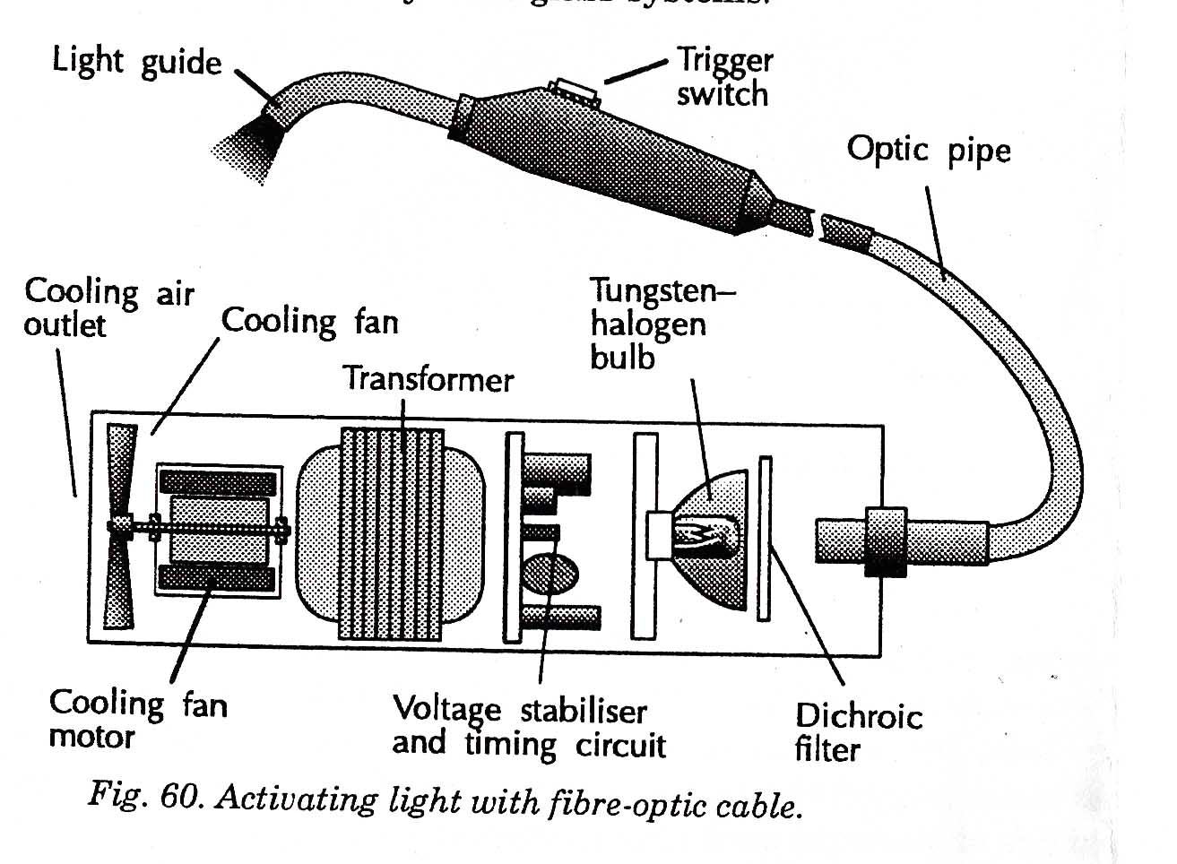
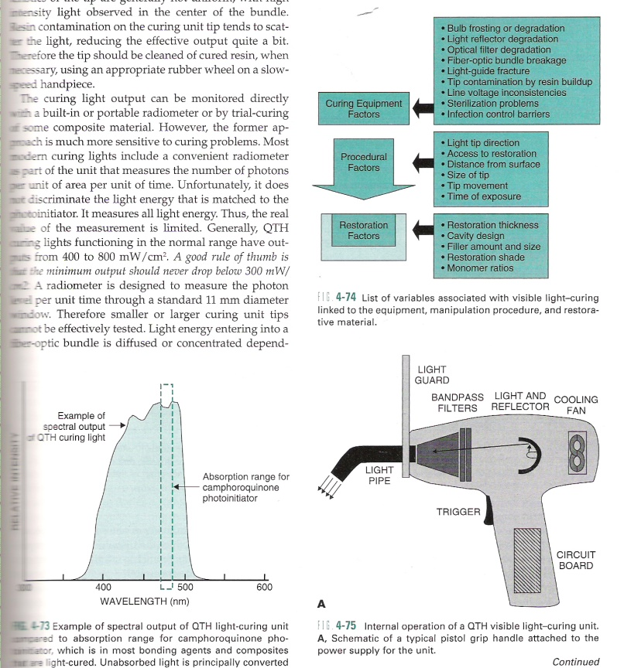
Counter top units
Types of devices…
Gun type units-features

Slide 5
Counter top units
Gun type units
Fiber optic handpiece curing attachments
  Smaller diameter of light guide
  Less intense light source
  Periodic need for replacement of fiber optic cords.

Slide 6
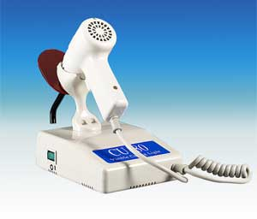
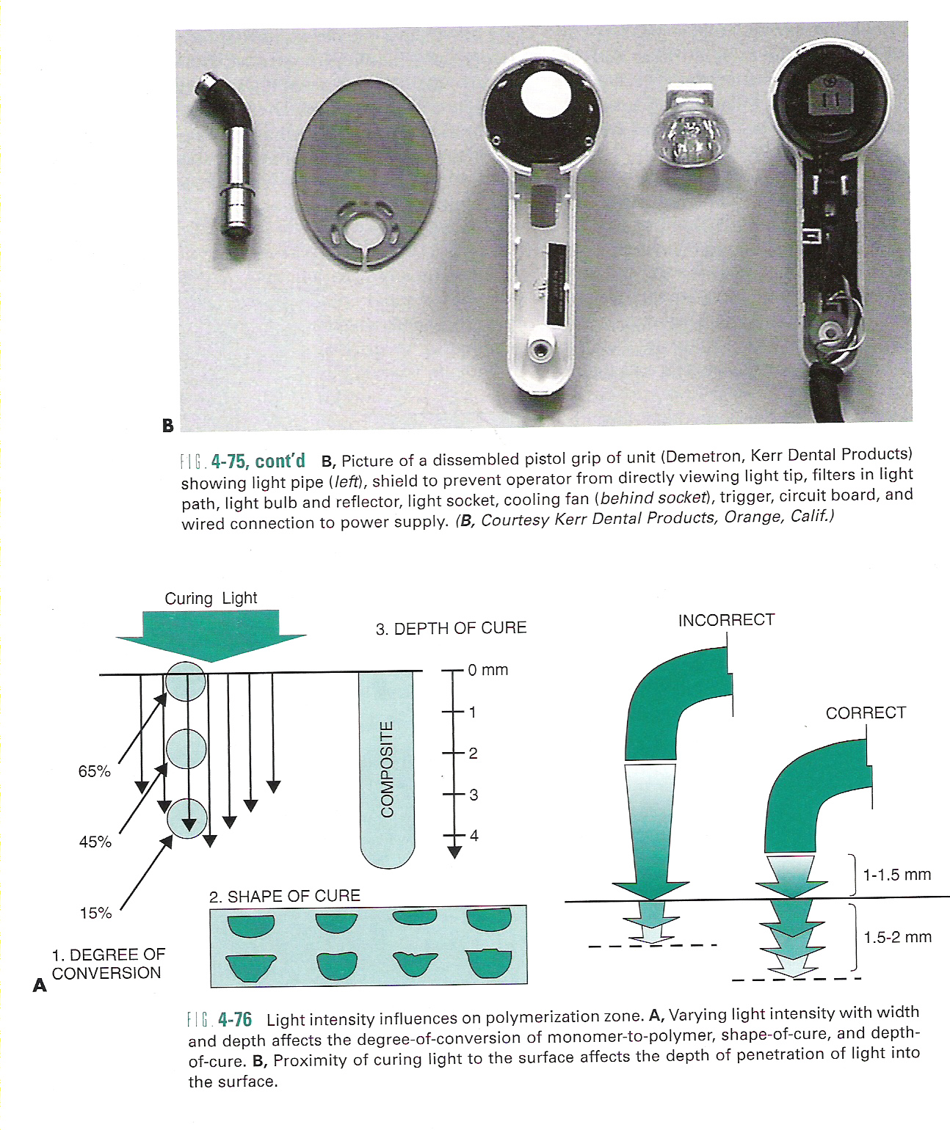
Quartz-Tungsten-Halogen units
CONVENTIONAL HALOGEN CURING LAMPS
E.g.: Optilux 500
Advantages
  Less cost
  Simple, well known
  technology
  Little/no heat

Slide 7
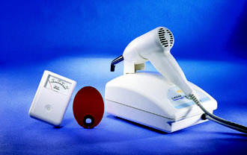
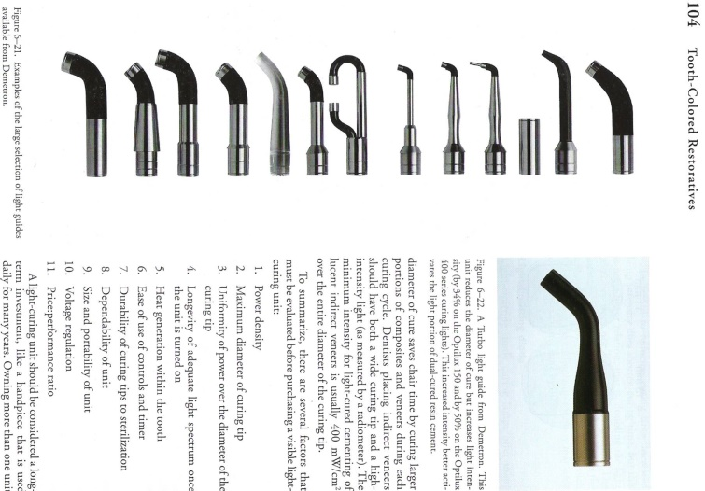
Disadvantages
  Slow cure time
  Plug into electricity
  Large, cumbersome
  Decreased output
  Replace lamp
Light guides

Slide 8
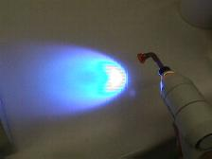
ENHANCED/ FAST HALOGEN LIGHTS (Christensen;JADA,Jun 2002)
E.g.: Optilux 501-Turbo Tip
Advantages
  Faster cure
  Proven technology
Disadvantages
  Narrower light guide
  Generate heat
  Higher cost

Slide 9
HIGH-INTENSITY HALOGEN LIGHTS (Christensen;JADA,Apr 2004)
E.g.: Swiss Master light
Very intense light
Water-cooling
Advantages
  Built-in radiometer
  Disposable curing tips
  Faster curing
Experimental

Slide 10
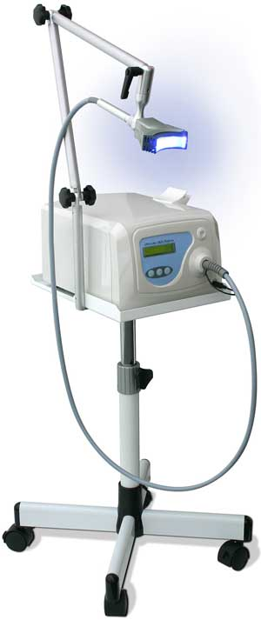
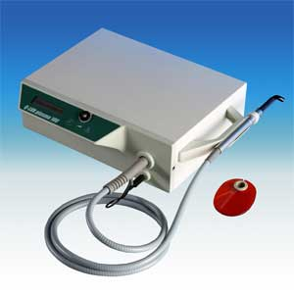
Plasma arc units
Advantages
  Curing time-3 sec
  Short procedure
Disadvantages
  Heat production
  High cost
  Replacement costly
  Large, bulky

Slide 11

Argon laser units
ADVANTAGES
  Correct wavelength
  Deeper & faster curing
  Better mech properties
  Decreased sensitivity to curing tip distance
  Less post-op sensitivity & discomfort
DISADVANTAGES
  Increased shrinkage, brittleness
  Marginal leakage
  Heat increase on surface
  Expensive
  Bulky equipment

Slide 12
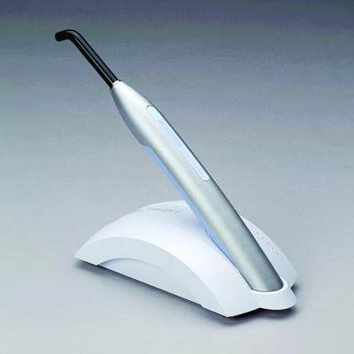
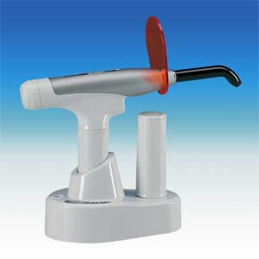
LED units
ADVANTAGES
  Cordless,light weight
  Long lasting
  No heat
  Moderate curing time
  Quiet
DISADVANTAGES
  New technology
  Slower than PAC
  Batteries must be recharged
  Higher cost
  Low intensity

Slide 13
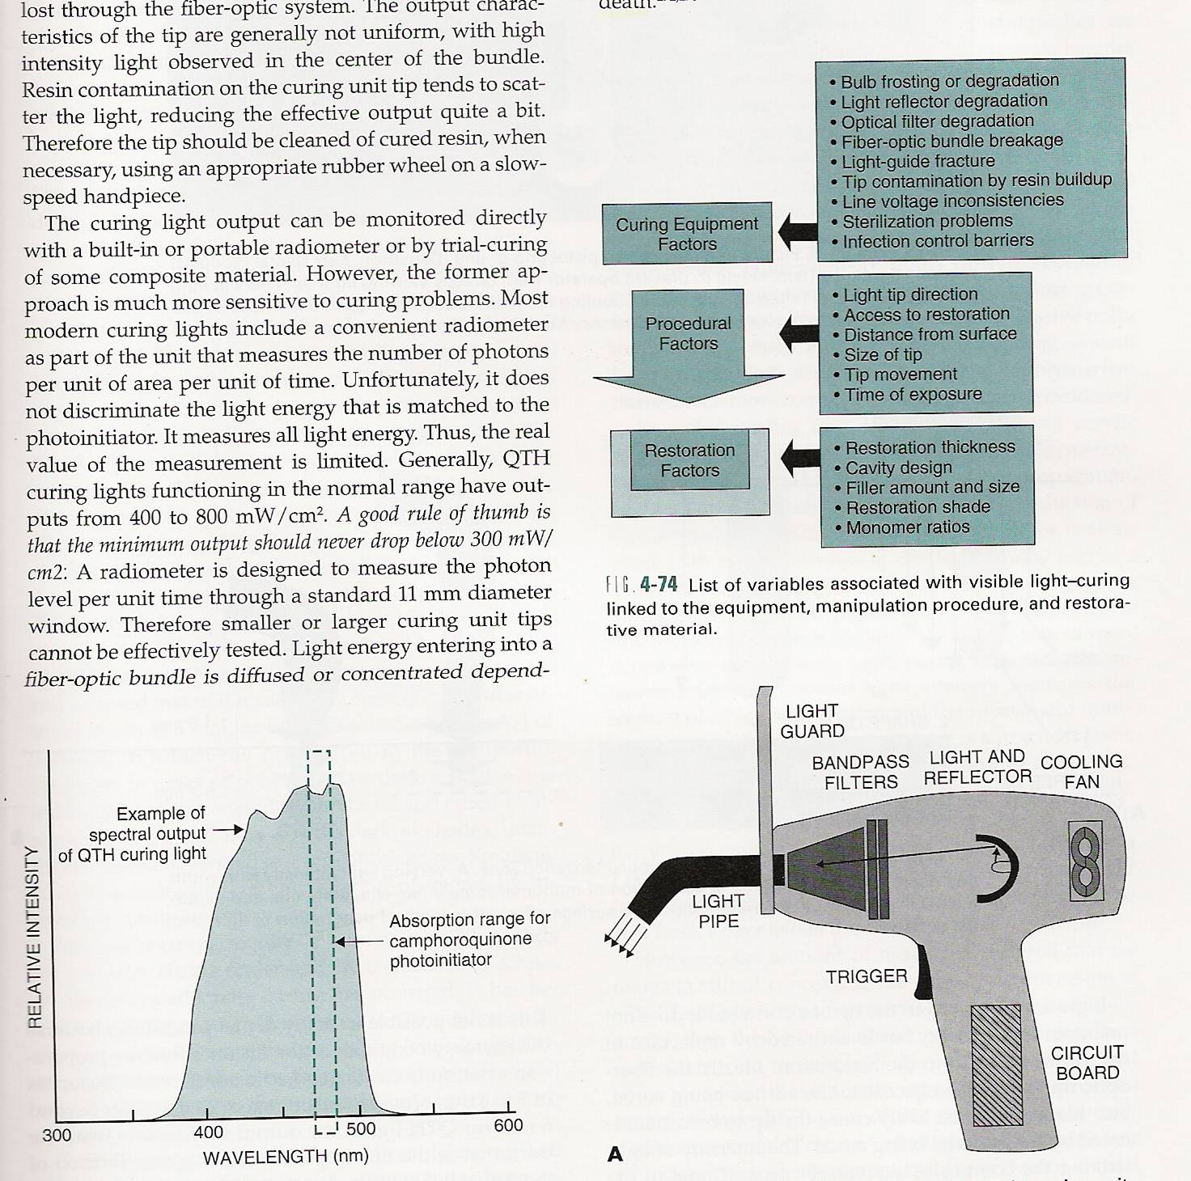
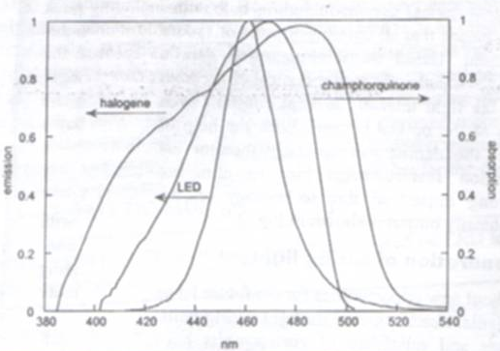
Light curing variables
Spectral output

Slide 14
Light curing variables

Slide 15
Procedural factors

Slide 16
Energy required: -16 J/cm² for 2mm
- 40 sec x 400 mW/cm²
Light attenuation: opacity, filler size, pigment shade, tooth structure -“SOGGY BOTTOM”
QTH, PAC, Laser-(> 1000mW/cm² )
  Depth of cure-increases
  Time of exposure-decreases
  Increases degree of conversion in deeper areas

Slide 17
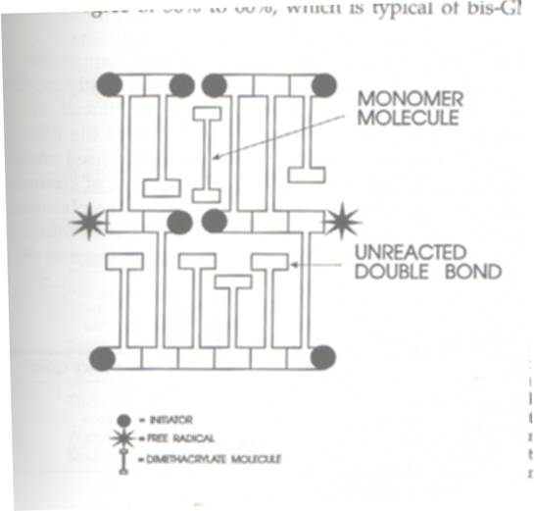
Degree of conversion
% of C-C double bonds that have been converted to single bonds to form polymeric resin
Strength, wear resistance
Avg 50-60%, light cure-44-75%
Cross linked , pendant, free groups
Factors
Light curing: more shrinkage stress
  Staining
  Sensitivity
  Secondary caries

Slide 18
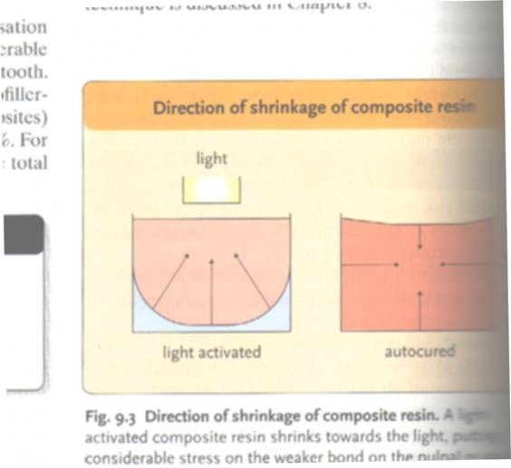
polymerization shrinkage
Value: 1- 4% , stress: 17MPa
Prevents bonding to dentin-strength required
Causes stress to develop
  Externally: interface of restoration & tooth
  Internally: between filler and resin
  Inelastic deformation of tooth (Sakaguchi, Dent Mat, 2005)

Slide 19
Factors affecting stress development
  Restorative technique
  Modulus of resin elasticity
  Polymerization rate
  Cavity configuration

Slide 20
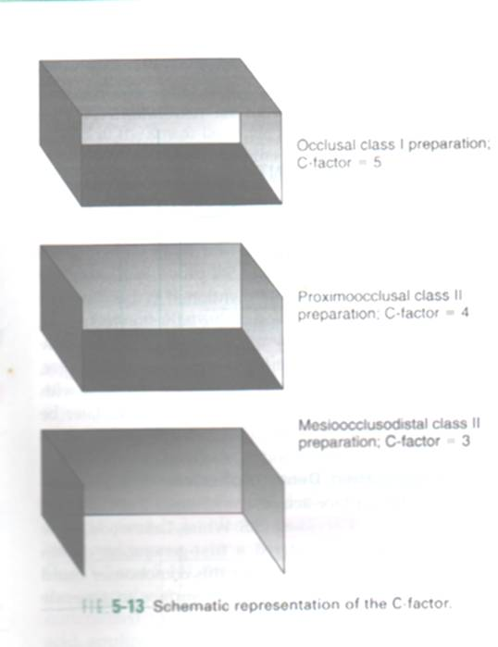
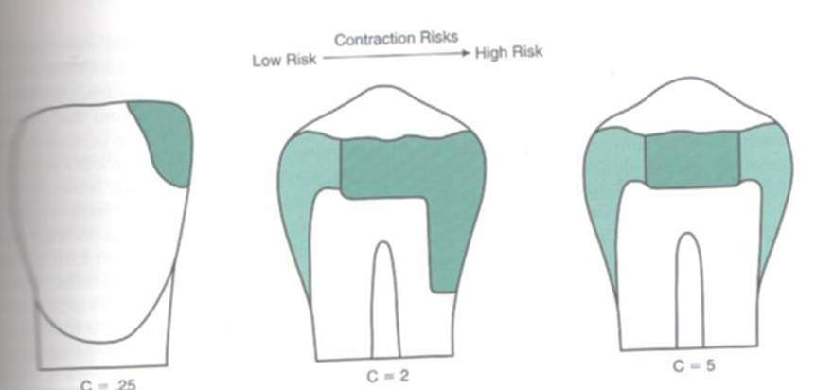
Cavity configuration
Ratio of bonded to non-bonded surface
Use of incremental/layering technique

Slide 21
REDUCTION OF RESIDUAL STRESS…
Reduction in vol contraction by alteration of chemistry
  Low shrink monomers
Clinical techniques
  Curing rate control
  Incremental build-up
  Resin based composite systems
  Dentin-enamel adhesive systems
  Using material which flows
  Material with low modulus of elasticity
  Introduction of air bubbles
Deliperi & Bardwell
JADA, Oct 2002
Combe & Burke,
Dental update2000

Slide 22
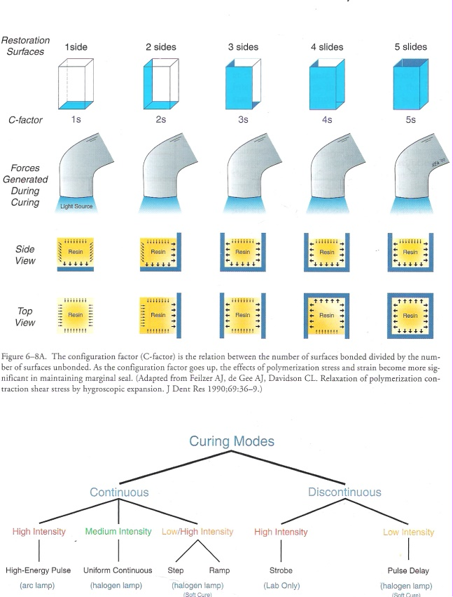
Curing techniques

Slide 23
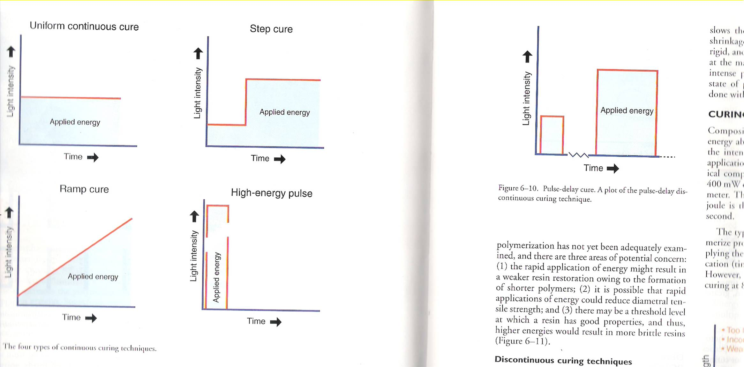
SOFT START-Mehl et al (1997)
10sec-150 mW/cm²
30-50 sec-700 mW/cm²
150mW/cm² increase to 1130 mW/cm² in 10 sec
Constant for 10 sec

Slide 24
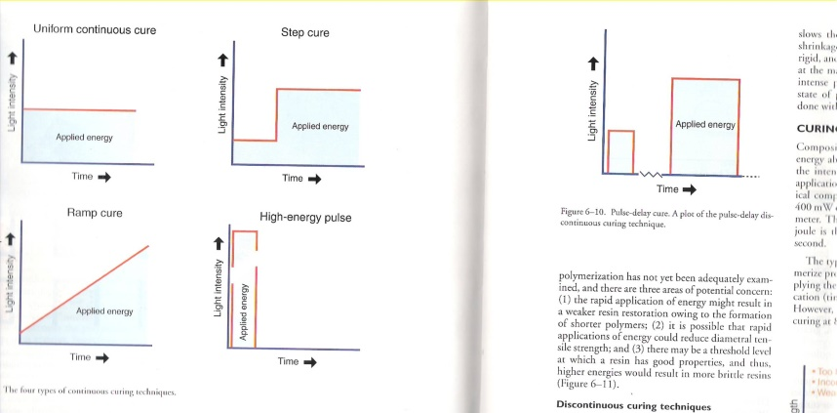
HIGH ENERGY PULSE CURING
400 mW/cm² -10 or 20 sec
Delay -10 or 20 sec
400 mW/cm² -10 or 20 sec
PULSE DELAY CURING
3 sec -200 mW/cm²
Delay -3-5 min, finish
30 sec -600 mW/cm²
Advantages of soft start

Slide 25
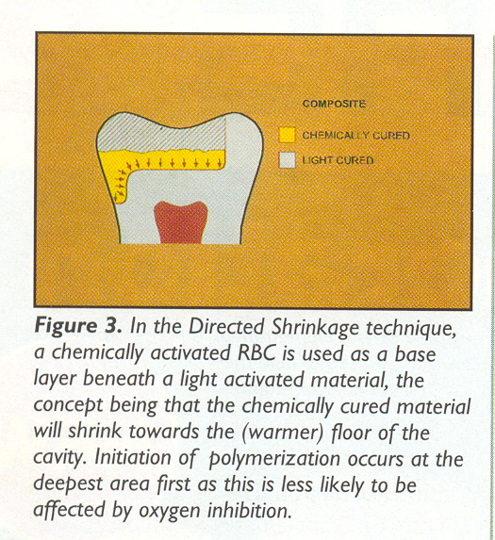
Placement techniques
(Deliperi & Bardwell, JADA,Oct 2002)
PLACEMENT TECHNIQUES
INCREMENTAL
TECHNIQUES
DIRECTED SHRINKAGE
TECHNIQUE
BULK TECNIQUE
Horizontal technique
Three-site technique
Oblique technique
Successive cusp build-up technique
Modified successive cusp build-up
Split incremental technique

Slide 26
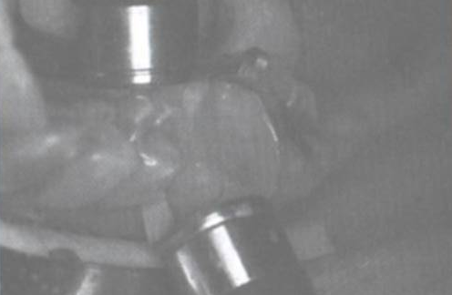
TRANS-ENAMEL POLYMERIZATION (Belvedere, DCNA, Jan 2001)

Slide 27
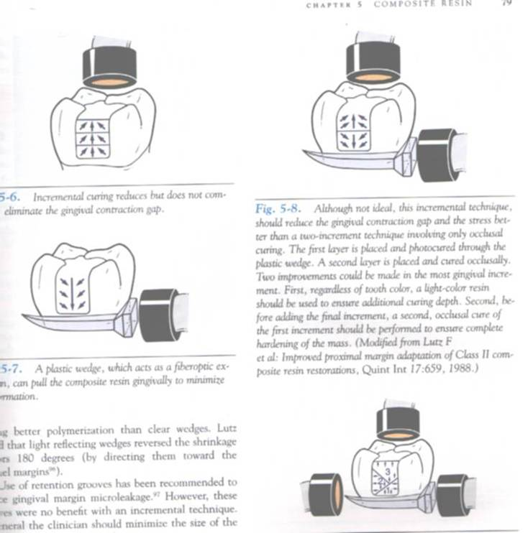
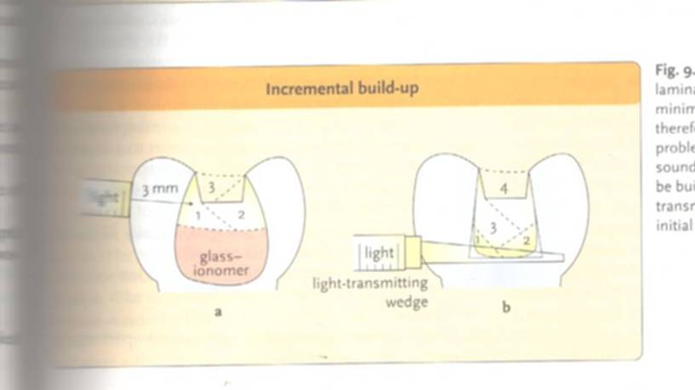
THREE-SITE TECHNIQUE

Slide 28
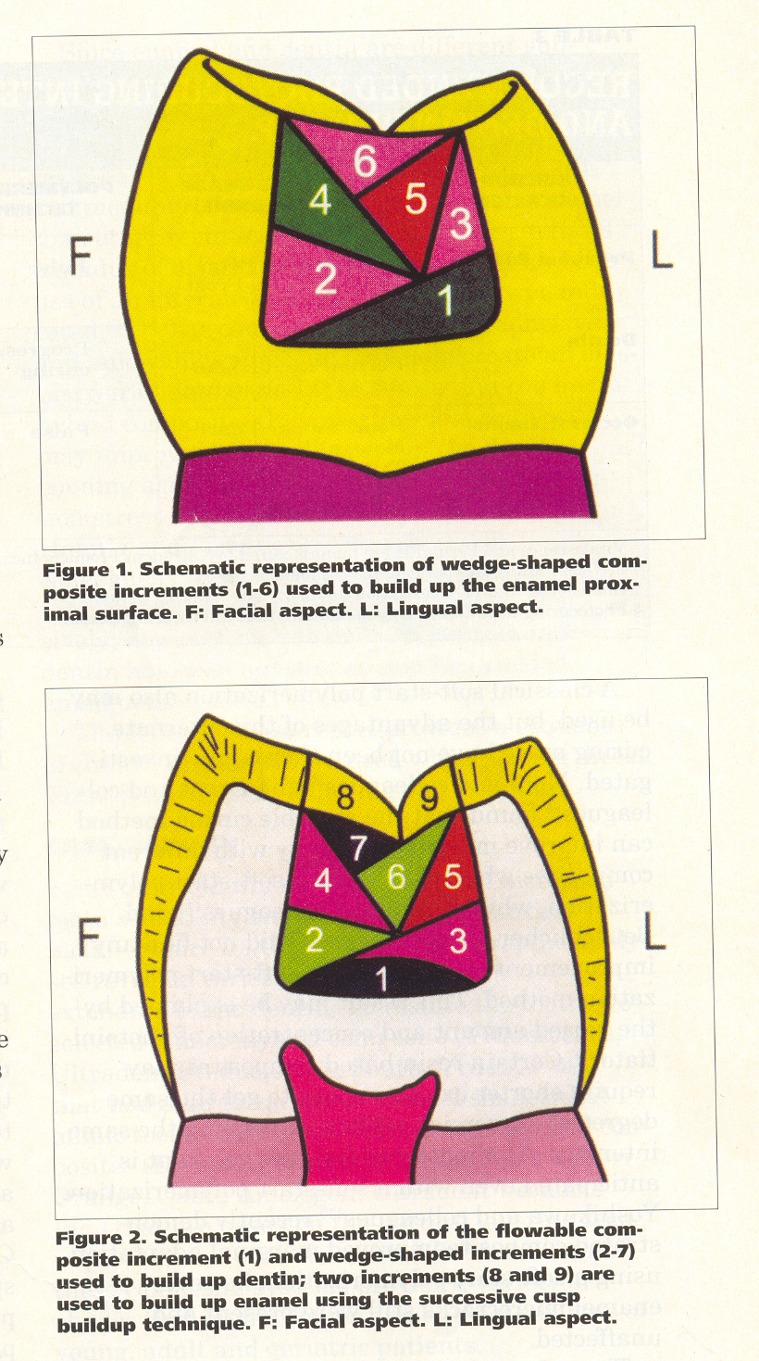
OBLIQUE TECHNIQUE

Slide 29
SUCCESSIVE CUSP BUILD-UP TECHNIQUE (Leibenberg, 1996)

Slide 30
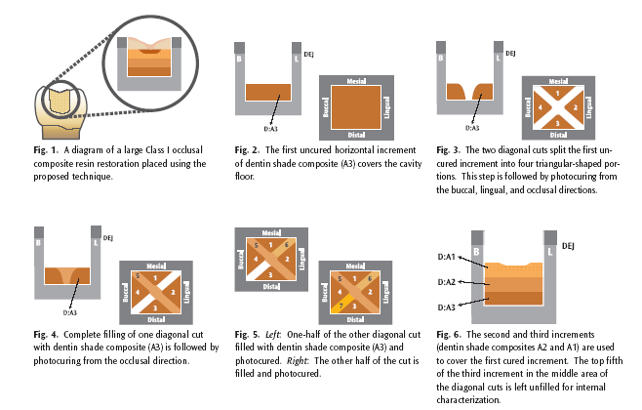
SPLIT INCREMENTAL TECHNIQUE
(Hassan & Khier, General dentistry, Nov-Dec 2005)

Slide 31
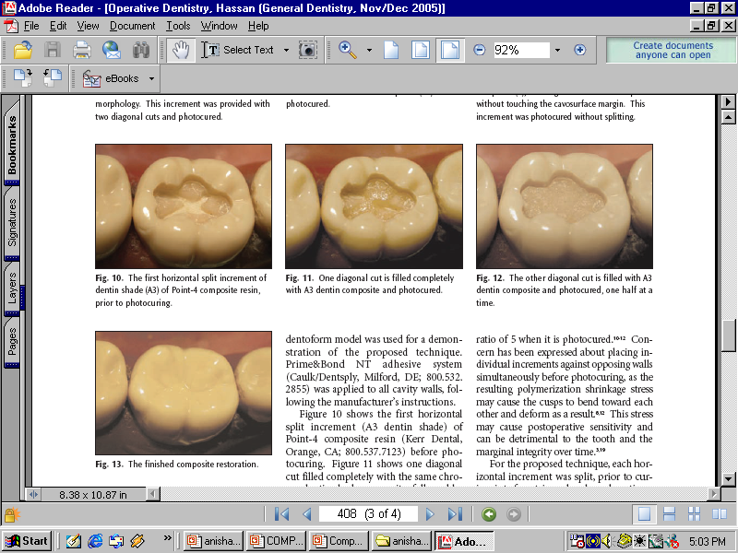

Slide 32
PROPERTIES…
PROPERTIES
PHYSICAL
MECHANICAL
CLINICAL
Working, setting time
Polymerization
shrinkage
Thermal properties
Water sorption
Solubility
Colour stability
Flexural strength
Compressive strength
Knoop hardness
Bond strength
Rigidity
Fracture toughness
creep
Wear
Depth of cure
Radiopacity
Biocompatibility
Staining
Secondary caries
Marginal integrity
Post-op sensitivity

Slide 33
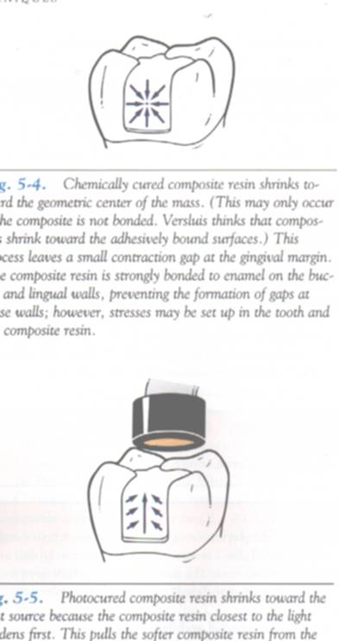
Physical properties
WORKING & SETTING TIME
  Light cure: surface hardens in 60-90 sec
  Chemical cure: 3-5 min
POLYMERIZATION SHRINKAGE
  Light cure: 60% in 60 sec
    Debonding, cusp fracture
    Macrofilled:1-2.5%
    Microfilled:2-3.5%
    Microhybrid:0.6-1.4%
  Chemical cure: even, towards centre

Slide 34
THERMAL PROPERTIES
  Places additional strain on bond-percolation
  Values for tooth, amalgam, unfilled resins, composites
COLOUR STABILITY
  Stains
  Change of colour
    Stress cracks
    Debonding of filler
    Oxidation
    Water sorption
WATER SORPTION & SOLUBILITY
  Macrofilled: 0.-1.1 mg/cm²
  Microfilled: 1.5-2 mg/cm²
  Solubility: 0.01-0.06 mg/cm²
  Benefits
  Colour instability, leaching, less wear resistance

Slide 35
Mechanical properties
FLEXURAL STRENGTH & MODULUS
  50% less for microfilled, flowable composites
  Thus used in cervical lesions
COMPRESSIVE STRENGTH
  Similar for all (240-290 MPa)
  Transverse strength-45-125 MPa
KNOOP HARDNESS
  Hybrid: 35-65 KHN
  Microfilled: 18-30 KHN
BOND STRENGTH
  For enamel, dentin
  For other substrates

Slide 36
RIGIDITY
  Microfilled: 4-8 GPa
  Hybrid: 8-19 GPa (similar to dentin)
  Large MOD restorations
CREEP
  Microfilled: creep
FRACTURE TOUGHNESS
  Resistance to crack growth
  Microfilled: 0.7-1.2 MNm^{-1.5}
  Hybrid: 1.4 – 2 MNm^{-1.5}
  Decreases with time

Slide 37
TAKE HOME MESSAGE
In late 1960s ,composites were introduced as an alternative to silicates and unfilled resins
Composite refers to a solid formed from two or more distinct phases that have been combined to produce properties superior to or intermediate to those of individual constituent
The first light curing units used UV light to set the material ,later these were replaced by visible light curing systems

Slide 38
QUESTIONS
Describe Techniques of composite placements
Clinical properties of composites
Comparision of chemical and light cure composites

Slide 39
References
Operative Dentistry – MA Marzouk
Art & science of operative Dentistry – Sturdevants (5th edition)
Art & Science of Operative Dentistry – Sturdevants (South Asian Edition)
Textbook Of Operative Dentistry – Vimal K Sikri (1st Edition)
Dental Anatomy, Physiology & Occlusion – Wheeler’s (9th Edition)
Optimizing tooth form with direct posterior composite restorations JCD Oct-Dec 2011 | Vol 14 | Issue 4

Slide 40
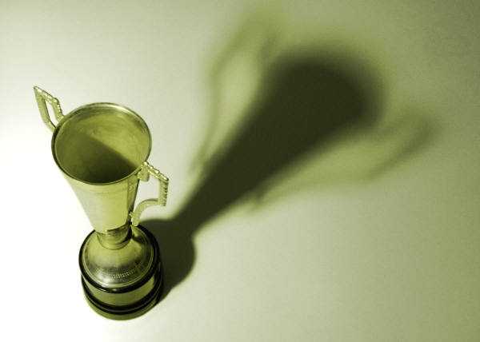
“The world hates change, yet it is the only thing that has brought progress.”
-Charles Kettering
THANK YOU

